Slide 1

IMDB Score Prediction
Jessica Davis
MBA Candidate
Kansas State University

Slide 2
Project Objectives
Objective: Determine which variables can be used to accurately predict IMDB score and therefore movie success
Success Criteria
Determine Variables that correlate to higher IMDB scores
Describe the relationship between important movie variables and IMDB score
Create models that accurately predict IMDB scores
Express how stakeholders can use this information
Methods:
Regression Analysis
Classification Analysis
Clustering Analysis

Slide 3
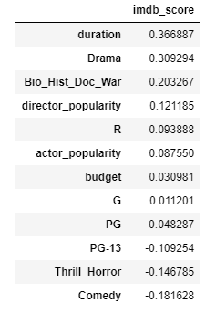
Data Transformation
Removed missing values
Removed columns
Created new columns for
Genre: Drama, Biographies_History_War_Documentaries, Comedy, Thirller_Horror
Content Rating: G, PG, PG-13, R
Changed columns into categories
Added up all actor Facebook likes and created categories for actor popularity (1-4)
Changed director Facebook likes into categories

Slide 4
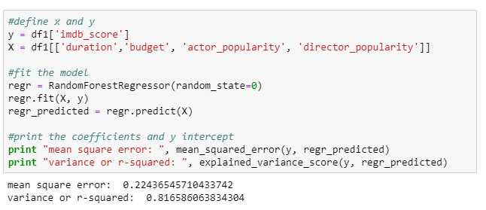
Regression Analysis
Best model: Random Forest
Original Model used all variables in the slide above
MSE: .21
R-squared .83
Consolidated Model
X: duration, budget, actor popularity, director popularity, Drama
MSE: .22
R-squared .82
Stakeholders only need 4 numbers and one yes or no answer to run model

Slide 5
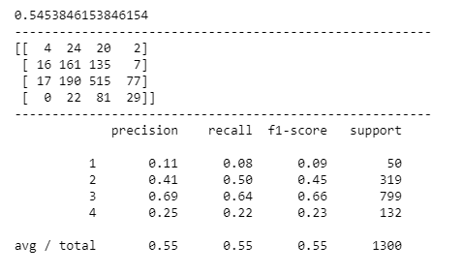
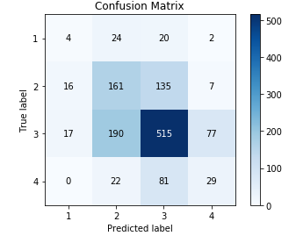
Classification Analysis
Split IMDB into 4 classification categories
Model: Decision Tree
11% accurate in predicting category 1
41% accurate in predicting category 2
69% accurate in predicting category 3
25% accurate in predicting category 4
Random Forest
Accuracy: 62.6%
All models had a poor predictions of IMDB Category 1

Slide 6
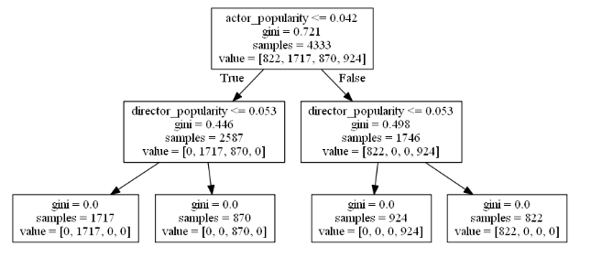
Clustering Analysis
K-means and Hierarchical
Used Duration, Budget, Actor Popularity and Director Popularity
4 Clusters
Cluster 1 (6-8): high act pop, low dir pop
Cluster 2: (4-6) low act pop, low dir pop, budgets high, long
Cluster 3: (4) low act pop, high dir pop, budgets low, short
Cluster 4: (6-8) high act pop, low dir pop, high budgets
Most important: Actor Popularity and Director Popularity

Slide 7
Summary
Regression: Early ROI
What is the duration?
What is the budget?
Is it a Drama (Y/N)?
What is the popularity of top three actors
What is the director popularity
Classification: Short-term resource allocation
Predicted Classification 3 well
Did not predict Classification 1 well
Clustering: Stand-Out potential
Popular Actors and Directors
Budget and duration

